Slide 1
import | as
import | as
import |  | as
'googleplaystore.csv'
Rating \ 0
4.1
1
3.9
App
Category
Photo Editor & Candy Camera & Grid & ScrapBook
ART_AND_DESIGN
Coloring book moana
ART_AND_DESIGN
2 U Launcher Lite – FREE Live Cool Themes, Hide ... 4.7
3
4.5
4
4.3
ART_AND_DESIGN
Sketch - Draw & Paint
ART_AND_DESIGN
Pixel Draw - Number Art Coloring Book
ART_AND_DESIGN
 | Reviews | Size | Installs | Type | Price | Content Rating | \
0 | 159 | 19M | 10,000+ | Free | 0 | Everyone
1 | 967 | 14M | 500,000+ | Free | 0 | Everyone
2 | 87510 | 8.7M | 5,000,000+ | Free | 0 | Everyone
3 | 215644 | 25M | 50,000,000+ | Free | 0 | Teen
4 | 967 | 2.8M | 100,000+ | Free | 0 | Everyone
Genres
0 Art & Design
Art & Design;Pretend Play
Art & Design
Art & Design
Art & Design;Creativity
Last Updated January 7, 2018
January 15, 2018
August 1, 2018
June 8, 2018
June 20, 2018
Current Ver \
1.0.0
2.0.0
1.2.4
Varies with device
1.1
Android Ver 0 4.0.3 and up
4.0.3 and up
4.0.3 and up
4.2 and up
4.4 and up
<class 'pandas.core.frame.DataFrame'> RangeIndex: 10841 entries, 0 to 10840 Data columns (total 13 columns):
# Column
--- ------
0 App
Non-Null Count
--------------
10841 non-null
Dtype
-----
object

Slide 2
1 | Category |  | 10841 non-null |  | object
2 | Rating |  | 9367 non-null |  | float64
3 | Reviews |  | 10841 | non-null | object
4 | Size |  | 10841 | non-null | object
5 | Installs |  | 10841 | non-null | object
6 | Type |  | 10840 | non-null | object
7 | Price |  | 10841 | non-null | object
8 | Content | Rating | 10840 | non-null | object
9 | Genres |  | 10841 | non-null | object
10 | Last Updated |  | 10841 | non-null | object
11 | Current Ver |  | 10833 | non-null | object
12 | Android Ver |  | 10838 | non-null | object
dtypes: float64(1), object(12) memory usage: 1.1+ MB
(10841, 13)
any
App Category Rating Reviews Size Installs Type Price
Content Rating Genres
Last Updated Current Ver Android Ver dtype: bool
False False True False False False True False True False False True True
sum
App Category Rating Reviews Size Installs Type Price
Content Rating Genres
Last Updated Current Ver
0
0
1474
0
0
0
1
0
1
0
0
8

Slide 3
Android Ver dtype: int64
3
any
App Category Rating Reviews Size Installs Type Price
Content Rating Genres
Last Updated Current Ver Android Ver dtype: bool
False False False False False False False False False False False False False
(9360, 13)
in
"Size"
"Size"
float
'M' 0
if 'M' in
else float 0 for
Rating \ 0
4.1
1
3.9
App
Category
Photo Editor & Candy Camera & Grid & ScrapBook
ART_AND_DESIGN
Coloring book moana
ART_AND_DESIGN
2 U Launcher Lite – FREE Live Cool Themes, Hide ... 4.7
3
4.5
4
4.3
ART_AND_DESIGN
Sketch - Draw & Paint
ART_AND_DESIGN
Pixel Draw - Number Art Coloring Book
ART_AND_DESIGN
 | Reviews | Size | Installs | Type | Price | Content Rating | \
0 | 159 | 19.0 | 10,000+ | Free | 0 | Everyone
1 | 967 | 14.0 | 500,000+ | Free | 0 | Everyone
2 | 87510 | 8.7 | 5,000,000+ | Free | 0 | Everyone
3 | 215644 | 25.0 | 50,000,000+ | Free | 0 | Teen
4 | 967 | 2.8 | 100,000+ | Free | 0 | Everyone

Slide 4
Genres
Last Updated
Current Ver \
0 |  |  | Art & Design | January 7, | 2018 |  | 1.0.0
1 | Art | & | Design;Pretend Play | January 15, | 2018 |  | 2.0.0
2 |  |  | Art & Design | August 1, | 2018 |  | 1.2.4
3 |  |  | Art & Design | June 8, | 2018 | Varies with | device
4 | Art |  | & Design;Creativity | June 20, | 2018 |  | 1.1
Android Ver 0 4.0.3 and up
4.0.3 and up
4.0.3 and up
4.2 and up
4.4 and up
"Size" 1000
"Size"
App
Category 0
\
Photo Editor & Candy Camera & Grid & ScrapBook
ART_AND_DESIGN 1 ART_AND_DESIGN
Coloring book moana
2
U Launcher Lite – FREE Live Cool Themes, Hide ...
ART_AND_DESIGN 3 ART_AND_DESIGN 4 ART_AND_DESIGN
...
... 10834
FAMILY 10836 FAMILY 10837 FAMILY 10839
BOOKS_AND_REFERENCE
Sketch - Draw & Paint
Pixel Draw - Number Art Coloring Book
...
FR Calculator
Sya9a Maroc - FR
Fr. Mike Schmitz Audio Teachings
The SCP Foundation DB fr nn5n
10840
LIFESTYLE
iHoroscope - 2018 Daily Horoscope & Astrology
Rating Reviews 4.1 159
3.9 967
4.7 87510
Size
Installs
Type Price Content Rating Free 0 Everyone
Free 0 Everyone
Free 0 Everyone
\ 0
19000.0
10,000+
1
14000.0
500,000+
2
8700.0
5,000,000+

Slide 5
3 | 4.5 | 215644 | 25000.0 | 50,000,000+ | Free | 0 | Teen
4 | 4.3 | 967 | 2800.0 | 100,000+ | Free | 0 | Everyone
... | ... | ... | ... | ... | ... | ... | ...
10834 | 4.0 | 7 | 2600.0 | 500+ | Free | 0 | Everyone
10836 | 4.5 | 38 | 53000.0 | 5,000+ | Free | 0 | Everyone
10837 | 5.0 | 4 | 3600.0 | 100+ | Free | 0 | Everyone
10839 | 4.5 | 114 | 0.0 | 1,000+ | Free | 0 | Mature 17+
10840 | 4.5 | 398307 | 19000.0 | 10,000,000+ | Free | 0 | Everyone
\ 0
Genres
Last Updated
Current Ver
Art & Design
January 7, 2018
1.0.0
1
Art & Design;Pretend Play
January 15, 2018
2.0.0
2
Art & Design
August 1, 2018
1.2.4
3
Art & Design
June 8, 2018
Varies with device
4
Art & Design;Creativity
June 20, 2018
1.1
...
...
...
...
10834
Education
June 18, 2017
1.0.0
10836
Education
July 25, 2017
1.48
10837 | Education | July 6, | 2018 |  |  | 1.0
10839 | Books & Reference | January 19, | 2015 | Varies | with | device
10840 | Lifestyle | July 25, | 2018 | Varies | with | device
0
1
2
3
4
... 10834
Android Ver
4.0.3 and up
4.0.3 and up
4.0.3 and up
4.2 and up
4.4 and up
...
4.1 and up

Slide 6
10836
10837
10839
10840
4.1 and up
4.1 and up Varies with device Varies with device
[9360 rows x 13 columns]
<class 'pandas.core.frame.DataFrame'> Int64Index: 9360 entries, 0 to 10840 Data columns (total 13 columns):
# Column
--- ------
Non-Null Count
--------------
Dtype
-----
0 | App |  | 9360 | non-null | object
1 | Category |  | 9360 | non-null | object
2 | Rating |  | 9360 | non-null | float64
3 | Reviews |  | 9360 | non-null | object
4 | Size |  | 9360 | non-null | float64
5 | Installs |  | 9360 | non-null | object
6 | Type |  | 9360 | non-null | object
7 | Price |  | 9360 | non-null | object
8 | Content | Rating | 9360 | non-null | object
9 | Genres |  | 9360 | non-null | object
10 | Last Updated |  | 9360 | non-null | object
11 | Current Ver |  | 9360 | non-null | object
12 | Android Ver |  | 9360 | non-null | object
dtypes: float64(2), object(11) memory usage: 1023.8+ KB
"Reviews" "Reviews"
float
<class 'pandas.core.frame.DataFrame'> Int64Index: 9360 entries, 0 to 10840 Data columns (total 13 columns):
# Column
--- ------
Non-Null Count
--------------
Dtype
-----
0 | App |  | 9360 | non-null | object
1 | Category |  | 9360 | non-null | object
2 | Rating |  | 9360 | non-null | float64
3 | Reviews |  | 9360 | non-null | float64
4 | Size |  | 9360 | non-null | float64
5 | Installs |  | 9360 | non-null | object
6 | Type |  | 9360 | non-null | object
7 | Price |  | 9360 | non-null | object
8 | Content | Rating | 9360 | non-null | object
9 | Genres |  | 9360 | non-null | object
10 Last Updated
9360 non-null
object

Slide 7
11 | Current Ver | 9360 non-null | object
12 | Android Ver | 9360 non-null | object
dtypes: float64(3), object(10) memory usage: 1023.8+ KB
 | "Installs" | float |  | '+' | '' | ',' | '' | if '+'
in | or ',' in | else float 0 | for | in |  | "Installs"
Rating \ 0
4.1
1
3.9
App
Category
Photo Editor & Candy Camera & Grid & ScrapBook
ART_AND_DESIGN
Coloring book moana
ART_AND_DESIGN
2 U Launcher Lite – FREE Live Cool Themes, Hide ... 4.7
3
4.5
4
4.3
ART_AND_DESIGN
Sketch - Draw & Paint
ART_AND_DESIGN
Pixel Draw - Number Art Coloring Book
ART_AND_DESIGN
 | Reviews | Size | Installs | Type | Price | Content Rating | \
0 | 159.0 | 19000.0 | 10000.0 | Free | 0 | Everyone
1 | 967.0 | 14000.0 | 500000.0 | Free | 0 | Everyone
2 | 87510.0 | 8700.0 | 5000000.0 | Free | 0 | Everyone
3 | 215644.0 | 25000.0 | 50000000.0 | Free | 0 | Teen
4 | 967.0 | 2800.0 | 100000.0 | Free | 0 | Everyone
 |  |  | Genres | Last | Updated |  | Current Ver | \
0 |  |  | Art & Design | January | 7, 2018 |  | 1.0.0
1 | Art | & | Design;Pretend Play | January 15, |  | 2018 | 2.0.0
2 |  |  | Art & Design | August 1, |  | 2018 | 1.2.4
3 |  |  | Art & Design | June 8, |  | 2018 | Varies with device
4
Art & Design;Creativity
June 20, 2018
1.1
Android Ver 0 4.0.3 and up
4.0.3 and up
4.0.3 and up
4.2 and up
4.4 and up
<class 'pandas.core.frame.DataFrame'> Int64Index: 9360 entries, 0 to 10840 Data columns (total 13 columns):
# Column
--- ------
Non-Null Count
--------------
Dtype
-----

Slide 8
0 | App |  | 9360 | non-null | object
1 | Category |  | 9360 | non-null | object
2 | Rating |  | 9360 | non-null | float64
3 | Reviews |  | 9360 | non-null | float64
4 | Size |  | 9360 | non-null | float64
5 | Installs |  | 9360 | non-null | float64
6 | Type |  | 9360 | non-null | object
7 | Price |  | 9360 | non-null | object
8 | Content | Rating | 9360 | non-null | object
9 | Genres |  | 9360 | non-null | object
10 | Last Updated |  | 9360 | non-null | object
11 | Current Ver |  | 9360 | non-null | object
12 | Android Ver |  | 9360 | non-null | object
dtypes: float64(4), object(9) memory usage: 1023.8+ KB
"Installs" "Installs"
int
<class 'pandas.core.frame.DataFrame'> Int64Index: 9360 entries, 0 to 10840 Data columns (total 13 columns):
# Column
--- ------
Non-Null Count
--------------
Dtype
-----
0 | App |  | 9360 | non-null | object
1 | Category |  | 9360 | non-null | object
2 | Rating |  | 9360 | non-null | float64
3 | Reviews |  | 9360 | non-null | float64
4 | Size |  | 9360 | non-null | float64
5 | Installs |  | 9360 | non-null | int64
6 | Type |  | 9360 | non-null | object
7 | Price |  | 9360 | non-null | object
8 | Content | Rating | 9360 | non-null | object
9 | Genres |  | 9360 | non-null | object
10 | Last Updated |  | 9360 | non-null | object
11 | Current Ver |  | 9360 | non-null | object
12 | Android Ver |  | 9360 | non-null | object
dtypes: float64(3), int64(1), object(9) memory usage: 1023.8+ KB
in
'Price' float '$' 1
'Price'
if '$' in
else float 0 for
Rating \ 0
4.1
1
App
Category
Photo Editor & Candy Camera & Grid & ScrapBook
ART_AND_DESIGN
Coloring book moana
ART_AND_DESIGN

Slide 9
3.9
2 U Launcher Lite – FREE Live Cool Themes, Hide ... 4.7
3
4.5
4
4.3
ART_AND_DESIGN
Sketch - Draw & Paint
ART_AND_DESIGN
Pixel Draw - Number Art Coloring Book
ART_AND_DESIGN
 | Reviews | Size | Installs | Type | Price | Content Rating | \
0 | 159.0 | 19000.0 | 10000 | Free | 0.0 | Everyone
1 | 967.0 | 14000.0 | 500000 | Free | 0.0 | Everyone
2 | 87510.0 | 8700.0 | 5000000 | Free | 0.0 | Everyone
3 | 215644.0 | 25000.0 | 50000000 | Free | 0.0 | Teen
4 | 967.0 | 2800.0 | 100000 | Free | 0.0 | Everyone
 |  |  | Genres | Last Updated |  |  | Current Ver |  | \
0 |  |  | Art & Design | January 7, 2018 |  |  | 1.0.0
1 | Art | & | Design;Pretend Play | January 15, 2018 |  |  | 2.0.0
2 |  |  | Art & Design | August 1, 2018 |  |  | 1.2.4
3 |  |  | Art & Design | June 8, | 2018 | Varies | with | device
4 | Art |  | & Design;Creativity | June 20, | 2018 |  |  | 1.1
Android Ver 0 4.0.3 and up
4.0.3 and up
4.0.3 and up
4.2 and up
4.4 and up
<class 'pandas.core.frame.DataFrame'> Int64Index: 9360 entries, 0 to 10840 Data columns (total 13 columns):
# Column
--- ------
Non-Null Count
--------------
Dtype
-----
0 | App |  | 9360 | non-null | object
1 | Category |  | 9360 | non-null | object
2 | Rating |  | 9360 | non-null | float64
3 | Reviews |  | 9360 | non-null | float64
4 | Size |  | 9360 | non-null | float64
5 | Installs |  | 9360 | non-null | int64
6 | Type |  | 9360 | non-null | object
7 | Price |  | 9360 | non-null | float64
8 | Content | Rating | 9360 | non-null | object
9 | Genres |  | 9360 | non-null | object
10 | Last Updated |  | 9360 | non-null | object
11 | Current Ver |  | 9360 | non-null | object
12 | Android Ver |  | 9360 | non-null | object

Slide 10
dtypes: float64(4), int64(1), object(8) memory usage: 1023.8+ KB
"Price" "Price" int
<class 'pandas.core.frame.DataFrame'> Int64Index: 9360 entries, 0 to 10840 Data columns (total 13 columns):
# Column
--- ------
Non-Null Count
--------------
Dtype
-----
0 | App |  | 9360 | non-null | object
1 | Category |  | 9360 | non-null | object
2 | Rating |  | 9360 | non-null | float64
3 | Reviews |  | 9360 | non-null | float64
4 | Size |  | 9360 | non-null | float64
5 | Installs |  | 9360 | non-null | int64
6 | Type |  | 9360 | non-null | object
7 | Price |  | 9360 | non-null | int64
8 | Content | Rating | 9360 | non-null | object
9 | Genres |  | 9360 | non-null | object
10 | Last Updated |  | 9360 | non-null | object
11 | Current Ver |  | 9360 | non-null | object
12 | Android Ver |  | 9360 | non-null | object
dtypes: float64(3), int64(2), object(8) memory usage: 1023.8+ KB
(9360, 13)
True
(9360, 13)
(9360, 13)
'Reviews'
1
'Reviews'
5
True
(9353, 13)
(9353, 13)
'Installs'
'Reviews'

Slide 11
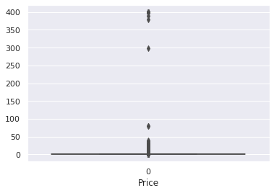
True
(9353, 13)
'Type'
'Free'
'Price'
0
import
set
as
'figure.figsize' 12 8
'Price'
'Reviews' 'Reviews'

Slide 12
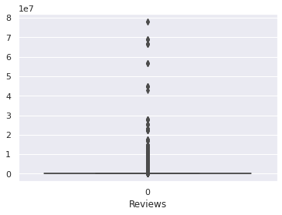
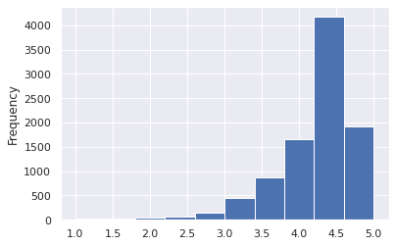
'Size'

Slide 13
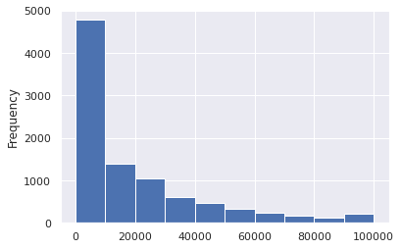
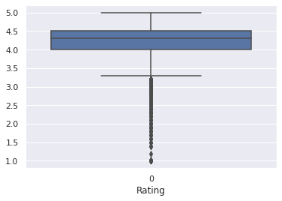
'Rating' 'Rating'
'Size'
'Size'

Slide 14
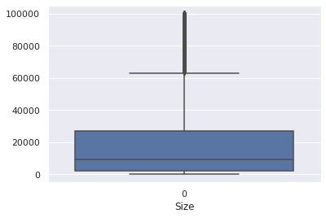
apply lambda if 'Price'
len
True
200 else False
True
1
(9353, 13)
2000000
(8900, 13)
.1 .25 .5 .70 .90 .95 .99
0
 | Rating | Reviews | Size | Installs | Price
0.10 | 3.5 | 18.00 | 0.0 | 1000.0 | 0.0
0.25 | 4.0 | 159.00 | 2600.0 | 10000.0 | 0.0
0.50 | 4.3 | 4255.50 | 9500.0 | 500000.0 | 0.0
0.70 | 4.5 | 35724.30 | 23000.0 | 1000000.0 | 0.0
0.90 | 4.7 | 295695.50 | 50000.0 | 10000000.0 | 0.0
0.95 | 4.8 | 637256.75 | 68000.0 | 10000000.0 | 1.0
0.99 | 5.0 | 1461766.93 | 95000.0 | 100000000.0 | 9.0
'Installs'
10000000
True

Slide 15
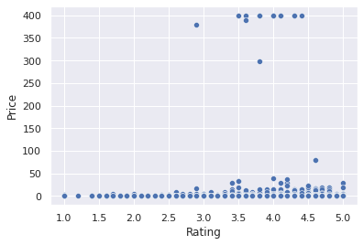
/tmp/ipykernel_350/3810112732.py:2: SettingWithCopyWarning:
A value is trying to be set on a copy of a slice from a DataFrame
See the caveats in the documentation:
https://pandas.pydata.org/pandas-docs/stable/user_guide/indexing.html# returning-a-view-versus-a-copy
data.drop(data[data['Installs'] > 10000000].index, inplace = True)
(8511, 13)
'Rating' 'Rating' 'Price'
'Price'
'Rating' 'Rating'
'Size'
'Size'

Slide 16
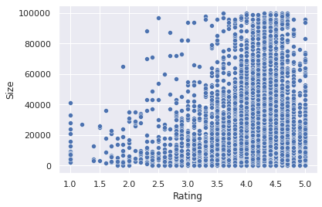
'Rating' 'Rating' 'Reviews'
'Reviews'

Slide 17
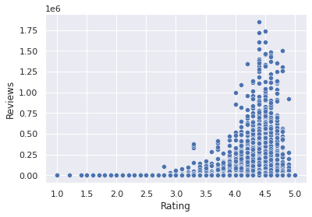
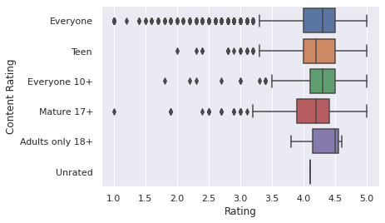
"Rating" "Content Rating"
<AxesSubplot: xlabel='Rating', ylabel='Content Rating'>

Slide 18
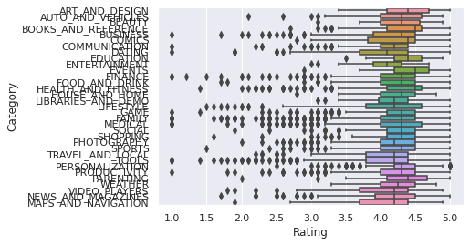
"Rating" "Category"
<AxesSubplot: xlabel='Rating', ylabel='Category'>
Rating \ 0
4.1
1
3.9
App
Category
Photo Editor & Candy Camera & Grid & ScrapBook
ART_AND_DESIGN
Coloring book moana
ART_AND_DESIGN
2 U Launcher Lite – FREE Live Cool Themes, Hide ... 4.7
4
4.3
5
4.4
ART_AND_DESIGN
Pixel Draw - Number Art Coloring Book
ART_AND_DESIGN
Paper flowers instructions
ART_AND_DESIGN
 | Reviews | Size | Installs | Type | Price | Content Rating | \
0 | 159.0 | 19000.0 | 10000 | Free | 0 | Everyone
1 | 967.0 | 14000.0 | 500000 | Free | 0 | Everyone

Slide 19
2 | 87510.0 | 8700.0 | 5000000 | Free | 0 | Everyone
4 | 967.0 | 2800.0 | 100000 | Free | 0 | Everyone
5 | 167.0 | 5600.0 | 50000 | Free | 0 | Everyone
Genres
Android
Last Updated Current Ver Ver
0 January 7, 2018 1.0.0
up
1 Art & Design;Pretend Play January 15, 2018 2.0.0
up
2 August 1, 2018 1.2.4
up
4 June 20, 2018 1.1
up
5 March 26, 2017 1.0
up
Art & Design
4.0.3 and
4.0.3 and
Art & Design
4.0.3 and
Art & Design;Creativity
4.4 and
Art & Design
2.3 and
/tmp/ipykernel_350/3545313420.py:1: FutureWarning: Dropping of nuisance columns in DataFrame reductions (with 'numeric_only=None') is deprecated; in a future version this will raise TypeError. Select only valid columns before calling the reduction.
inp1.skew()
Rating | -1.746804
Reviews | 4.580662
Size | 1.657389
Installs | 1.546381
Price | 23.326873
dtype: float64
'Reviews' 'Reviews'
/tmp/ipykernel_350/3380202217.py:2: SettingWithCopyWarning:
A value is trying to be set on a copy of a slice from a DataFrame. Try using .loc[row_indexer,col_indexer] = value instead
See the caveats in the documentation:
https://pandas.pydata.org/pandas-docs/stable/user_guide/indexing.html# returning-a-view-versus-a-copy
inp1['Reviews'] = reviewskew
-0.19795445828004443
'Installs' 'Installs'

Slide 20
0 | 10000
1 | 500000
2 | 5000000
4 | 100000
5 | 50000
 | ...
10834 | 500
10836 | 5000
10837 | 100
10839 | 1000
10840 | 10000000
Name: | Installs, Length: 8511, dtype: int64
-0.5063710333961149
Rating \ 0
4.1
1
3.9
App
Category
Photo Editor & Candy Camera & Grid & ScrapBook
ART_AND_DESIGN
Coloring book moana
ART_AND_DESIGN
2 U Launcher Lite – FREE Live Cool Themes, Hide ... 4.7
4
4.3
5
4.4
ART_AND_DESIGN
Pixel Draw - Number Art Coloring Book
ART_AND_DESIGN
Paper flowers instructions
ART_AND_DESIGN
 | Reviews | Size | Installs | Type | Price | Content Rating | \
0 | 5.075174 | 19000.0 | 10000 | Free | 0 | Everyone
1 | 6.875232 | 14000.0 | 500000 | Free | 0 | Everyone
2 | 11.379520 | 8700.0 | 5000000 | Free | 0 | Everyone
4 | 6.875232 | 2800.0 | 100000 | Free | 0 | Everyone
5 | 5.123964 | 5600.0 | 50000 | Free | 0 | Everyone
Genres
Last Updated Current Ver January 7, 2018 1.0.0
January 15, 2018 2.0.0
August 1, 2018 1.2.4
June 20, 2018 1.1
Android
Ver 0
up
1 Art & Design;Pretend Play up
2
up 4
up
Art & Design
4.0.3 and
4.0.3 and
Art & Design
4.0.3 and
Art & Design;Creativity
4.4 and

Slide 21
5
up
Art & Design
March 26, 2017
1.0
2.3 and
"Last Updated" "Current Ver" "Android Ver" "App" "Type" 1 True
/tmp/ipykernel_350/1867454288.py:1: SettingWithCopyWarning:
A value is trying to be set on a copy of a slice from a DataFrame
See the caveats in the documentation:
https://pandas.pydata.org/pandas-docs/stable/user_guide/indexing.html# returning-a-view-versus-a-copy
inp1.drop(["Last Updated","Current Ver","Android Ver","App","Type"],axis=1,inplace=True)
Rating
Category
\
Rating
Reviews
Size
Installs
Price Content
0 ART_AND_DESIGN
4.1
5.075174
19000.0
10000
0
Everyone
1 ART_AND_DESIGN
3.9
6.875232
14000.0
500000
0
Everyone
2
ART_AND_DESIGN
4.7 11.379520
8700.0
5000000
0
Everyone
4 ART_AND_DESIGN
4.3
6.875232
2800.0
100000
0
Everyone
5 ART_AND_DESIGN
4.4
5.123964
5600.0
50000
0
Everyone
Genres
0 Art & Design
Art & Design;Pretend Play
Art & Design
Art & Design;Creativity
Art & Design
(8511, 8)
Rating
Category
\
Rating
Reviews
Size
Installs
Price Content
0 ART_AND_DESIGN
4.1
5.075174
19000.0
10000
0
Everyone
1 ART_AND_DESIGN
3.9
6.875232
14000.0
500000
0
Everyone

Slide 22
2
ART_AND_DESIGN
4.7 11.379520
8700.0
5000000
0
Everyone
4 ART_AND_DESIGN
4.3
6.875232
2800.0
100000
0
Everyone
5 ART_AND_DESIGN
4.4
5.123964
5600.0
50000
0
Everyone
Genres
0 Art & Design
Art & Design;Pretend Play
Art & Design
Art & Design;Creativity
Art & Design
array(['ART_AND_DESIGN', 'AUTO_AND_VEHICLES', 'BEAUTY', 'BOOKS_AND_REFERENCE', 'BUSINESS', 'COMICS', 'COMMUNICATION', 'DATING', 'EDUCATION', 'ENTERTAINMENT', 'EVENTS', 'FINANCE', 'FOOD_AND_DRINK', 'HEALTH_AND_FITNESS', 'HOUSE_AND_HOME', 'LIBRARIES_AND_DEMO', 'LIFESTYLE', 'GAME', 'FAMILY', 'MEDICAL', 'SOCIAL', 'SHOPPING', 'PHOTOGRAPHY', 'SPORTS',
'TRAVEL_AND_LOCAL',
'TOOLS', 'PERSONALIZATION', 'PRODUCTIVITY', 'PARENTING', 'WEATHER',
'VIDEO_PLAYERS', 'NEWS_AND_MAGAZINES', 'MAPS_AND_NAVIGATION'],
dtype=object)
del
'Category' 'Category'
'Category'
1
/tmp/ipykernel_350/2005045317.py:1: SettingWithCopyWarning:
A value is trying to be set on a copy of a slice from a DataFrame. Try using .loc[row_indexer,col_indexer] = value instead
See the caveats in the documentation:
https://pandas.pydata.org/pandas-docs/stable/user_guide/indexing.html# returning-a-view-versus-a-copy
inp2.Category = pd.Categorical(inp2.Category)
 | Rating | Reviews | Size | Installs | Price | Content Rating | \
0 | 4.1 | 5.075174 | 19000.0 | 10000 | 0 | Everyone
1 | 3.9 | 6.875232 | 14000.0 | 500000 | 0 | Everyone
2 | 4.7 | 11.379520 | 8700.0 | 5000000 | 0 | Everyone

Slide 23
4 | 4.3 | 6.875232 | 2800.0 | 100000 | 0 | Everyone
5 | 4.4 | 5.123964 | 5600.0 | 50000 | 0 | Everyone
 |  | Genres | Category_ART_AND_DESIGN | \
0 |  | Art & Design | 1
1 | Art & | Design;Pretend Play | 1
2 |  | Art & Design | 1
4 | Art | & Design;Creativity | 1
5 |  | Art & Design | 1
Category_AUTO_AND_VEHICLES
Category_BEAUTY ...
Category_PERSONALIZATION | \
0 |  | 0 | 0 | ...
0
1 |  | 0 | 0 | ...
0
2 |  | 0 | 0 | ...
0
4 |  | 0 | 0 | ...
0
5 |  | 0 | 0 | ...
0
 | Category_PHOTOGRAPHY | Category_PRODUCTIVITY | Category_SHOPPING | \
0 | 0 | 0 | 0
1 | 0 | 0 | 0
2 | 0 | 0 | 0
4 | 0 | 0 | 0
5 | 0 | 0 | 0
0
1
2
4
5
Category_SOCIAL Category_SPORTS Category_TOOLS \ 0 0 0
0 0 0
0 0 0
0 0 0
0 0 0
Category_TRAVEL_AND_LOCAL
Category_VIDEO_PLAYERS
Category_WEATHER
0
0
0
0
1
0
0
0
2
0
0
0
4
0
0
0
5
0
0
0

Slide 24
[5 rows x 40 columns]
(8511, 40)
"Genres"
array(['Art & Design', 'Art & Design;Pretend Play',
'Art & Design;Creativity', 'Auto & Vehicles', 'Beauty',
'Books & Reference', 'Business', 'Comics', 'Comics;Creativity', 'Communication', 'Dating', 'Education', 'Education;Creativity', 'Education;Education', 'Education;Music & Video', 'Education;Action & Adventure', 'Education;Pretend Play', 'Education;Brain Games', 'Entertainment',
'Entertainment;Brain Games', 'Entertainment;Creativity', 'Entertainment;Music & Video', 'Events', 'Finance', 'Food &
Drink',
'Health & Fitness', 'House & Home', 'Libraries & Demo', 'Lifestyle', 'Lifestyle;Pretend Play', 'Card', 'Casual',
'Puzzle',
'Action', 'Arcade', 'Word', 'Racing', 'Casual;Creativity', 'Sports', 'Board', 'Simulation', 'Role Playing', 'Adventure', 'Strategy', 'Simulation;Education', 'Action;Action &
Adventure',
'Trivia', 'Casual;Brain Games', 'Simulation;Action & Adventure',
'Educational;Creativity', 'Puzzle;Brain Games', 'Educational;Education', 'Card;Brain Games', 'Educational;Brain Games', 'Educational;Pretend Play', 'Casual;Action & Adventure', 'Entertainment;Education', 'Casual;Education', 'Casual;Pretend Play', 'Music;Music &
Video',
'Racing;Action & Adventure', 'Arcade;Pretend Play', 'Adventure;Action & Adventure', 'Role Playing;Action &
Adventure',
'Simulation;Pretend Play', 'Puzzle;Creativity',
'Sports;Action & Adventure', 'Educational;Action & Adventure', 'Arcade;Action & Adventure', 'Entertainment;Action &
Adventure',
'Puzzle;Action & Adventure', 'Strategy;Action & Adventure', 'Music & Audio;Music & Video', 'Health & Fitness;Education', 'Adventure;Education', 'Board;Brain Games',
'Board;Action & Adventure', 'Board;Pretend Play', 'Casual;Music & Video', 'Role Playing;Pretend Play', 'Entertainment;Pretend Play', 'Video Players &

Slide 25
Editors;Creativity',
'Card;Action & Adventure', 'Medical', 'Social', 'Shopping', 'Photography', 'Travel & Local',
'Travel & Local;Action & Adventure', 'Tools', 'Tools;Education',
'Personalization', 'Productivity', 'Parenting', 'Parenting;Music & Video', 'Parenting;Brain Games', 'Parenting;Education', 'Weather', 'Video Players & Editors', 'Video Players & Editors;Music & Video', 'News & Magazines', 'Maps & Navigation', 'Health & Fitness;Action & Adventure', 'Music', 'Educational', 'Casino', 'Adventure;Brain Games', 'Lifestyle;Education', 'Books & Reference;Education', 'Puzzle;Education', 'Role Playing;Brain Games', 'Strategy;Education', 'Racing;Pretend Play', 'Communication;Creativity', 'Strategy;Creativity'],
dtype=object)
Since, There are too many categories under Genres. Hence, we will try to reduce some categories which have very few samples under them and put them under one new common category i.e. "Other".
for in if
20
'Other' if in else for in
"Genres"
array(['Art & Design', 'Other', 'Auto & Vehicles', 'Beauty', 'Books & Reference', 'Business', 'Comics', 'Communication', 'Dating', 'Education', 'Education;Education', 'Education;Pretend Play', 'Entertainment', 'Entertainment;Music & Video', 'Events', 'Finance', 'Food &
Drink',
'Health & Fitness', 'House & Home', 'Libraries & Demo', 'Lifestyle', 'Card', 'Casual', 'Puzzle', 'Action', 'Arcade',
'Word', 'Racing', 'Sports', 'Board', 'Simulation', 'Role Playing',
'Adventure', 'Strategy', 'Trivia', 'Educational;Education', 'Casual;Pretend Play', 'Medical', 'Social', 'Shopping', 'Photography', 'Travel & Local', 'Tools', 'Personalization', 'Productivity', 'Parenting', 'Weather', 'Video Players &
Editors',
'News & Magazines', 'Maps & Navigation', 'Educational', 'Casino'],
dtype=object)
'Genres' "Genres"

Slide 26
del
'Genres'
'Genres'
1
 | Rating | Reviews | Size | Installs | Price | Content Rating | \
0 | 4.1 | 5.075174 | 19000.0 | 10000 | 0 | Everyone
1 | 3.9 | 6.875232 | 14000.0 | 500000 | 0 | Everyone
2 | 4.7 | 11.379520 | 8700.0 | 5000000 | 0 | Everyone
4 | 4.3 | 6.875232 | 2800.0 | 100000 | 0 | Everyone
5 | 4.4 | 5.123964 | 5600.0 | 50000 | 0 | Everyone
Category_ART_AND_DESIGN
Category_AUTO_AND_VEHICLES
Category_BEAUTY \ 0
0
1
0
2
0
4
0
5
0
1
0
1
0
1
0
1
0
1
0
\ 0
Category_BOOKS_AND_REFERENCE
... Genres_Simulation
Genres_Social
0 ...
0
0
1
0 ...
0
0
2
0 ...
0
0
4
0 ...
0
0
5
0 ...
0
0
 | Genres_Sports | Genres_Strategy | Genres_Tools | Genres_Travel | & | Local
\
0 | 0 | 0 | 0 |  |  | 0
1 | 0 | 0 | 0 |  |  | 0
2 | 0 | 0 | 0 |  |  | 0
4 | 0 | 0 | 0 |  |  | 0
5 | 0 | 0 | 0 |  |  | 0

Slide 27
Genres_Trivia Genres_Word
Genres_Video Players & Editors
Genres_Weather
0 | 0 | 0 | 0
0
1 | 0 | 0 | 0
0
2 | 0 | 0 | 0
0
4 | 0 | 0 | 0
0
5 | 0 | 0 | 0
0
[5 rows x 91 columns]
(8511, 91)
"Content Rating"
array(['Everyone', 'Teen', 'Everyone 10+', 'Mature 17+', 'Adults only 18+', 'Unrated'], dtype=object)
'Content Rating' 'Content Rating'
del
'Content Rating' 'Content Rating'
'Content Rating'
1
Rating Reviews |  |  |  | Size | Installs | Price
Category_ART_AND_DESIGN |  |  |  | \
0 | 4.1 | 5.075174 | 19000.0 |  | 10000 | 0
1
1 | 3.9 | 6.875232 | 14000.0 |  | 500000 | 0
1
2 | 4.7 | 11.379520 | 8700.0 |  | 5000000 | 0
1
4 | 4.3 | 6.875232 | 2800.0 |  | 100000 | 0
1
5 | 4.4 | 5.123964 | 5600.0 |  | 50000 | 0
1
Category_AUTO_AND_VEHICLES
Category_BEAUTY

Slide 28
Category_BOOKS_AND_REFERENCE \ 0
0
1
0
2
0
4
0
5
0
0
0
0
0
0
0
0
0
0
0
Category_BUSINESS ... Genres_Trivia
Genres_Video Players &
Editors | \
0 |  | 0 | ... | 0
0
1 |  | 0 | ... | 0
0
2 |  | 0 | ... | 0
0
4 |  | 0 | ... | 0
0
5 |  | 0 | ... | 0
0
 | Genres_Weather | Genres_Word | Content | Rating_Adults | only | 18+ | \
0 | 0 | 0 |  |  |  | 0
1 | 0 | 0 |  |  |  | 0
2 | 0 | 0 |  |  |  | 0
4 | 0 | 0 |  |  |  | 0
5 | 0 | 0 |  |  |  | 0
 | Content | Rating_Everyone | Content | Rating_Everyone | 10+ | \
0 |  | 1 |  |  | 0
1 |  | 1 |  |  | 0
2 |  | 1 |  |  | 0
4 |  | 1 |  |  | 0
5 |  | 1 |  |  | 0
Content Rating_Mature | 17+ | Content | Rating_Teen | Content
Rating_Unrated
0 | 0 |  | 0
0
1 | 0 |  | 0
0
2 | 0 |  | 0
0
4 | 0 |  | 0
0
5 | 0 |  | 0

Slide 29
0
[5 rows x 96 columns]
(8511, | 96)
from from from |  | import import import | as | as | as
'Rating' 'Rating'
1
0.3 5
----------------------------------------------------------------------
-----
NameError Traceback (most recent call last)
/tmp/ipykernel_350/572442865.py in <cell line: 5>()
3 y_train = d1['Rating'] 4
----> 5 Xtrain, Xtest, ytrain, ytest = tts(X,y, test_size=0.3, random_state=5)
NameError: name 'X' is not defined
LinearRegression()
round
print "The R2 value of the Training Set is :
The R2 value of the Training Set is : 0.072
round 3
print "The R2 value of the Testing Set is :
3
" format
" format

